Slide 1


Slide 2
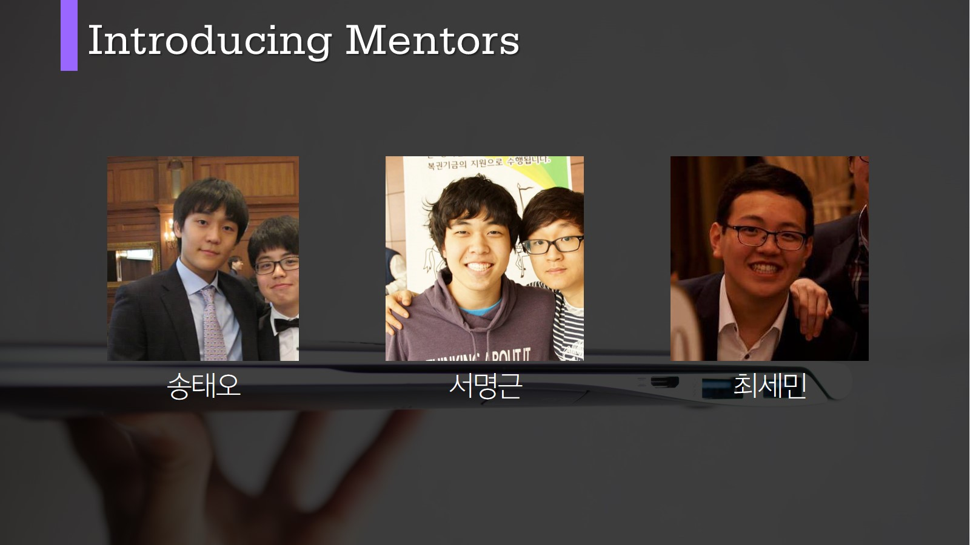

Slide 3
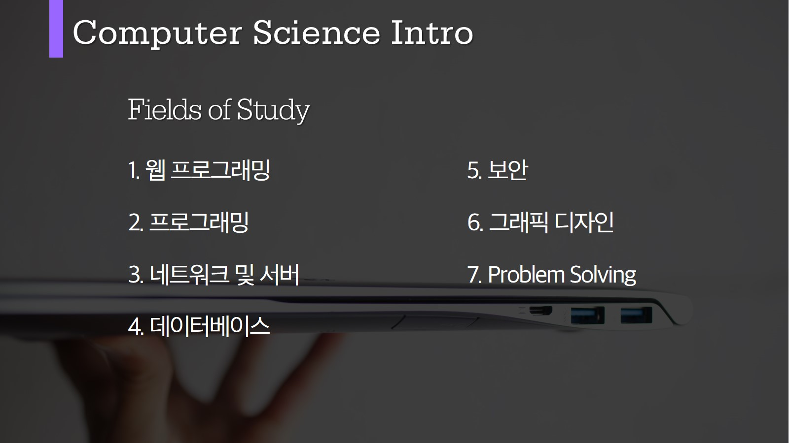

Slide 4


Slide 5


Slide 6
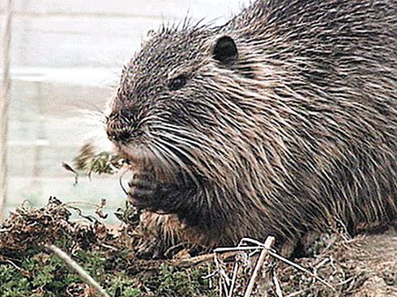
설치 Java & Eclipse
( ͡° ͜ʖ ͡°)

Slide 7
베껴. 외워. 숙제야.
1 public class Semin
2 {
3 public static void main(String[] args)
4 {
5
6 }
7 }

Slide 8
Print - println
1 public class Semin
2 {
3 public static void main(String[] args)
4 {
5 System.out.println("Hello, World!");
6 }
7
Hello, World!

Slide 9
Print - println
1 public class Semin
2 {
3 public static void main(String[] args)
4 {
5 System.out.println("Hello, World!");
6 System.out.println("Hello, World!");
7 }
Hello, World!
Hello, World!

Slide 10
Print - print
1 public class Semin
2 {
3 public static void main(String[] args)
4 {
5 System.out.print("Hello, World!");
6 System.out.println("오하이오");
7 }
Hello, World!오하이오

Slide 11
Print - print
1 public class Semin
2 {
3 public static void main(String[] args)
4 {
5 System.out.println("Hello, World!");
6 System.out.print("오하이오");
7 }
Hello, World!
오하이오

Slide 12
Semin Colon and Brackets
1 public class Semin
2 {
3 public static void main(String[] args)
4 {
5 System.out.println("Hello, World!");
6 }
7
#$#$%&@#$&$@*!

Slide 13
Notes
1 public class Semin
2 {
3 public static void main(String[] args)
4 {
5 System.out.println("Hello, World!");
6 //This note won’t be shown.
7 }
8 }
Hello, World!

Slide 14
Print - numbers
1 public class Semin
2 {
3 public static void main(String[] args)
4 {
5 System.out.println(0+1);
6 }
7 //참고로 Java는 + - * / % 의 연산이 가능함
8 }
1

Slide 15
Print
1 public class Semin
2 {
3 public static void main(String[] args)
4 {
5 System.out.println(“Hi”+“0+1”);
6 }
7
8 }
Hi01

Slide 16
Print
1 public class Semin
2 {
3 public static void main(String[] args)
4 {
5 System.out.println(“Hi”+0+1);
6 }
7
따옴표가 없어져따!

Slide 17
Print
1 public class Semin
2 {
3 public static void main(String[] args)
4 {
5 System.out.println(“Hi”+0+1);
6 }
7
Hi01

Slide 18
코드를 어떻게 하면
My lucky number is:
3, 4, 5
가 나올까요?
3가지 방법으로 만들어보긔

Slide 19
다음 기호가 뜻하는 것은?
//

Slide 20
다음 코드를 실행하면 각각 나오는 것은?
a. System.out.println("3 + 4");
b. System.out.println(3 + 4);
c. System.out.println(3 + "4");
Notes:
3 + 4
7
34

Slide 21
현제야 외워야 된다ㅎ
( ͡° ͜ʖ ͡°)
1 public class Semin
2 {
3 public static void main(String[] args)
4 {
5
6 }
7 }
Notes:
( ͡° ͜ʖ ͡°)

Slide 22
시간이 남아? Data Types
Number
byte 8 bit = 1 byte (-128~127)
short 16 bit = 2 byte (-32768~32767)
int 32 bit = 4 byte (-2^31~2^31-1)
long 64 bit = 8 byte (-2^63~2^63-1)
double 128 bit = you get the point
string
boolean

Slide 23
1
2
3
4
5
6
7
8
9
10
11
12
13
14

